Slide 1
Architecture
Overview

Slide 2

Agenda
System Overview
Architecture principles
High level architecture
Store architecture
Central platform
Data flow
Integration architecture
Security
Scalability
Deployment
Software distribution
Q&A

Slide 3



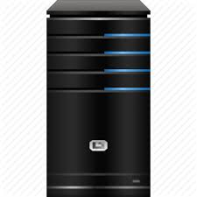



System Overview
Optional
Organization Structure
Parameter
Software distribution
Real time Transaction
Web Reporting
ERP - Back Office - BI Interface
Sales process
Store Operation
Local parameters
Local reporting

Slide 4

Architecture Principle
Built on Open Source stack based on Robust components and Modern Programming Language.
Deployed under Docker to guarantee scalability
Business Continuity its our compass on each technical decision:
- Distributed DB and logic at POS level (offline protection)
- Sanity check on data IN to guarantee data integrity
- Controlled Software Distribution

Slide 5










High Level Architecture
Common Stack
Device
Manager (JHIM)
Parameters
Transaction
manager
Software
distribution
Promo
Engine
Transaction
collection
IN/OUT
Interface

Slide 6

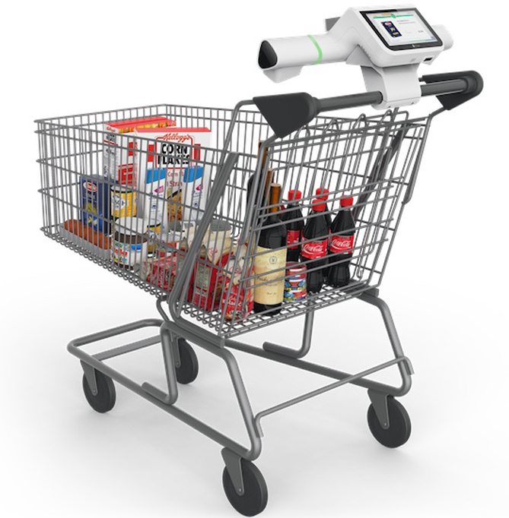


Store Architecture
Data & Logic are distributed at POS, SCO and kiosk to guarantee offline functionality.
In-Store Server its optional and it can be used when:
- Back Office is not centralized or web
- POS network isolation its required
- Reporting or invoicing its required also when offline
- Cart calculation is required by third parties
Back Office

Slide 7

Central Platform
Head Quarter
It is the centralized console to defined organization structure, parameters, Stores and device configurations.
Data exchange with the store is done in real time.
It exposes Standard API and Message Queue to interact with ERP, Back Office, BI etc
Deployed under Docker for scalability and Software update
Within Memphis components bi-directional data synchronization its guarantee by REBUS

Slide 8


ReBus : Retail Bus
Developed in Java, it uses hybrid technology
(MQTT and Web Services).
Each YELLOW Point communicates with its RED Point.
Sends transactions through queues (MQTT) and aligns the local database in "pull" mode using WS.

Slide 9



Data Flow
Loyalty
Back
Office
Optional
BI
REBUS
Catalog-price-promo-parms
Transaction

Slide 10
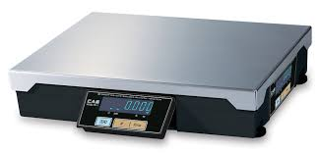
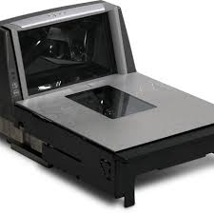


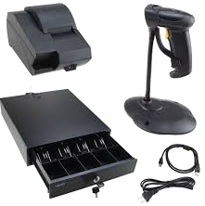
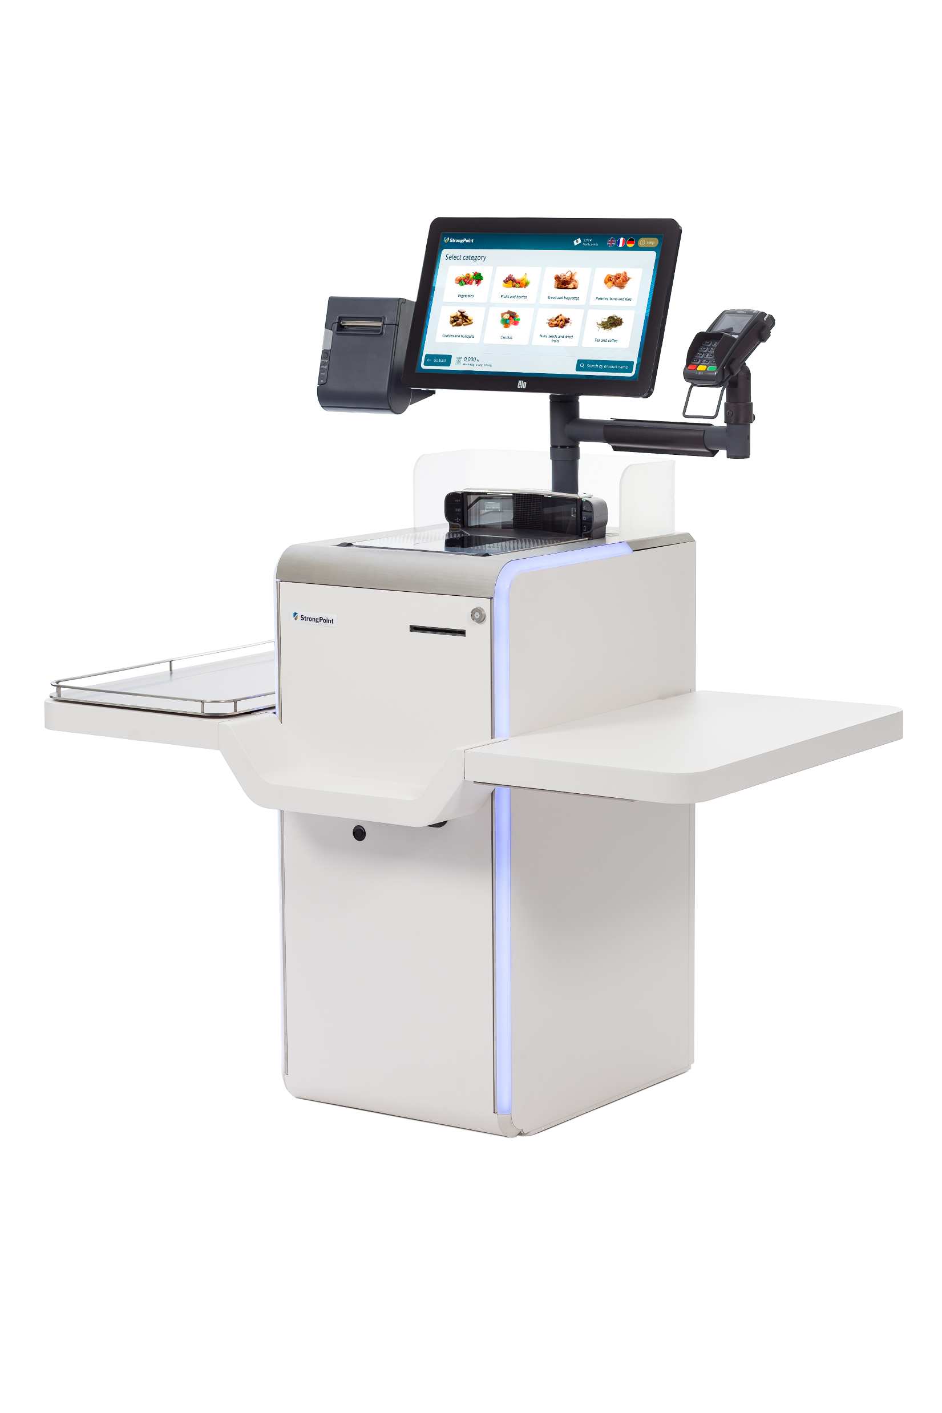

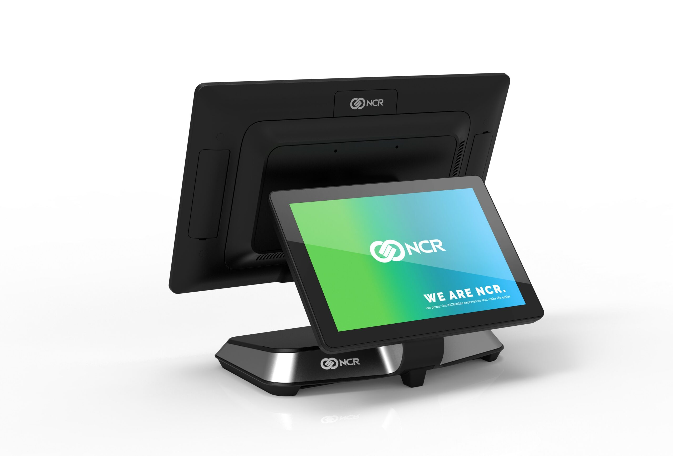
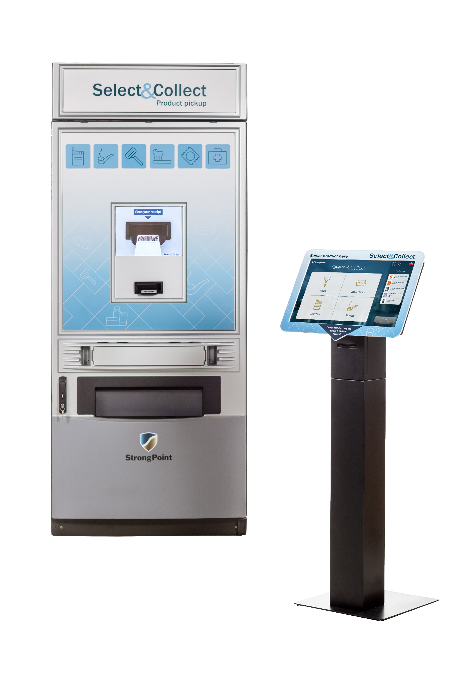

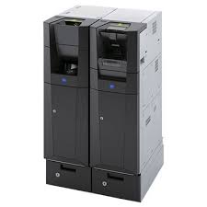
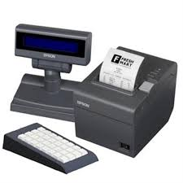
Integration Architecture
Retailer HQ Application
POS Peripherals
Third party application
JHIM
Java Hardware Interface Manager

Slide 11
Four API categories
Memphis export the following API categories:
FEED the Memphis with data (Catalog, Prices, Promotion, groups…)
RESEND via Message Queue a specific transaction period
CALCULATE price and discounts of a cart (cart can be parked and resumed from any touch point)
PRICE INQUIRY utilized by third parties Price Checker

Slide 12

Security
Normally Retail application are running in a protected network.
Following indication of a Third Party Audit we are working on the following aspects:
- Remove all the JAR files deprecated
- Update components to the latest available version
Artemis 2.37 commos-collections to 4.4+ upgrade Gson library to 2.8.9+ enforce SSL/TLS acceptors update to jetty 12 update to Java 17
API access are provided via token authentication.
Artemis supports communication encryption that we currently are not using considering it over killing.

Slide 13

Scalability
As described, the POS has all the data and logic deployed locally.
A large number of POS connected to the same server might delay local price update or transaction collection but it will not impact sales performance.
In any case, the architecture allow Scalability strategy depending on the bottleneck:
processing speed (CPU or Memory) can be solved distributing
Docker container on more servers
network traffic can be reduced installing Store servers on the
bigger stores

Slide 14



Deployment
Configuration
- Company, logo, store
- Device type and peripherals
- Define Department, tender, VAT….
Store Server Setup (if any)
- install Debian ISO - install ecli package
- run ecli setup with store # as parm
POS & SCO Setup
- Boot from Installation USB key - Assign IP
- Enter server IP and Device ID

Slide 15
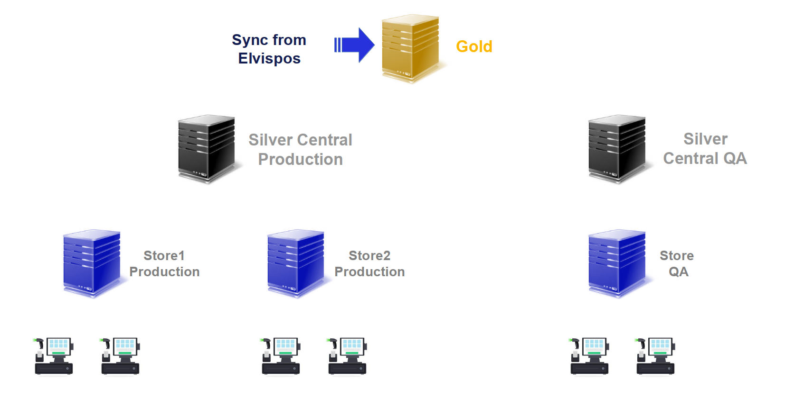
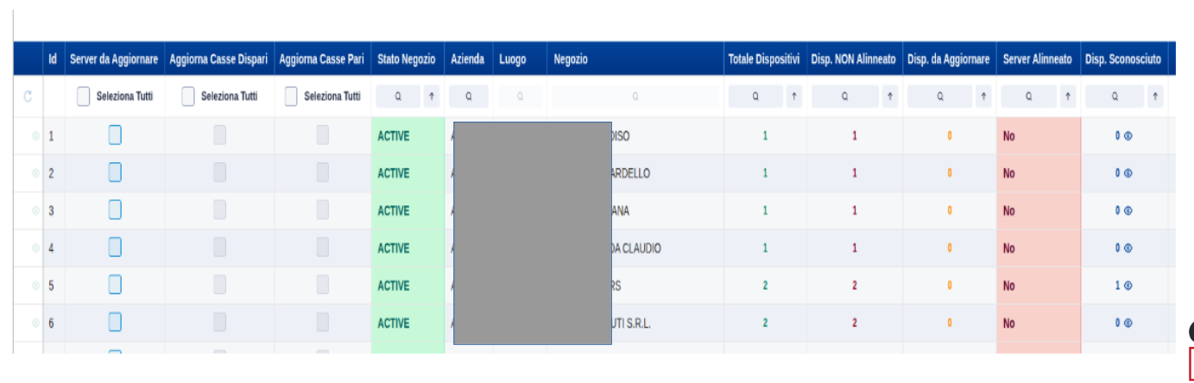
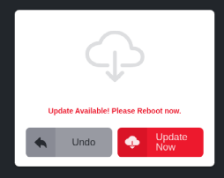
Software Distribution
New versions are made available by Elvispos on the GOLD machine.
A dashboard allows to determine which nodes to update (test lab, pilot, and then rollout) while having complete visibility of the installed versions.

Slide 16
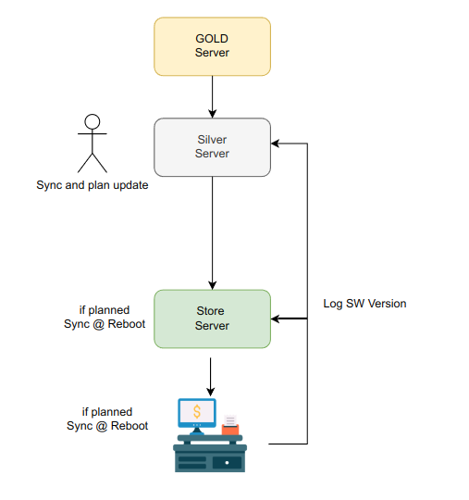
Software distribution process
The SILVER server updates itself with the information published on the GOLD server using the manually executed ecli sync command.
The dashboard allows you to schedule the update of a store server and the master checkout.
The appropriate table indicates for which node the software update is available.
During the nightly reboot, the software maintenance procedure sequentially aligns:
Datamodel
Parameters
Software
The node notifies you via the transaction log that the alignment has been completed.

Slide 17


Slide 18
Prepararsi sui temi fiscali
Spiegare coem si lavora in team remoti
Integration:
- articoli e promo
- vendite

