Slide 1
Jan 2026

Slide 2

Agenda
Team experience
Functional Perimeter
Vision
Promise and Challenge
Technology
Demo

Slide 3





Team History
1986
2005
Post Software
International
Retalix
Buy
1997
1997
2013
2015
Millennuim
POS Solution
NCR
Pac2000A Conad AmaCrai
Lando
FTS/EuroStore
Delhaize
Everest
Autogrill
StoreLine
Carrefour/Italy

Slide 4
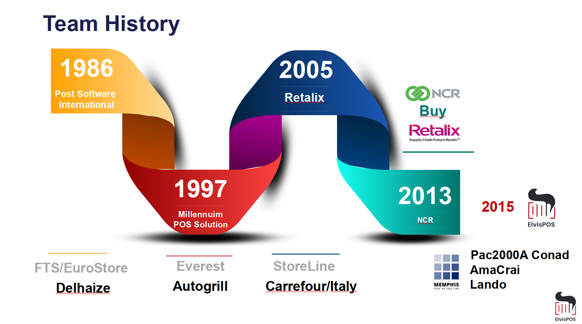

Slide 5
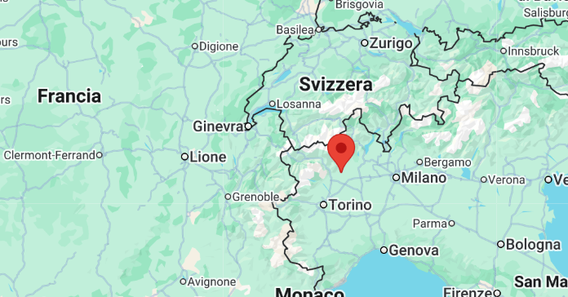


ElvisPOS
Founded by Alberto and Massimo on 2014 as Retail Consultancy Company
Soon we realized the market was demanding much more modern technology and we decided to invest and develop

Slide 6
Memphis Main References
PAC2000A
70 store initial rollout, contracted for 1500 installed. Standard Grocery, bar, restaurant, SCO and Shopic
AMACRAI
200+ stores; potential expansion on SECOM Group (1200 stores). Pilot in March
Lando
Hypermarket Grocery with Bar, restaurant and SCO running Memphis
ARD 27 Grocery stores in Sicily
Partners
GTN (Udine, North East),
GAB Tamagnini (Center & South Italy)
StrongPoint (Latvia, Lithuania and Estonia)

Slide 7



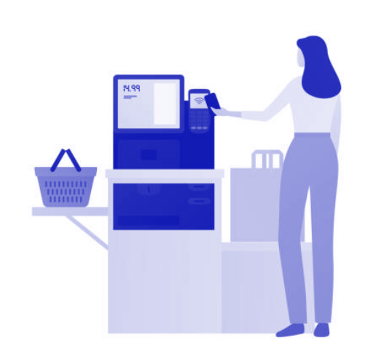







Functional Perimeter
Tendering
Device
Manager (JHIM)
Web
Reporting
Transaction
Manager
Pricing &
Discount
Loyalty &
Promo (PIM)
Store
Accounting
Refund &
Vouchers
Gift Cards
Rest API’s
3rd Parties
Assortment Price
Orders
Fulfilment
Inventory
Location MDM
E-commerce

Slide 8
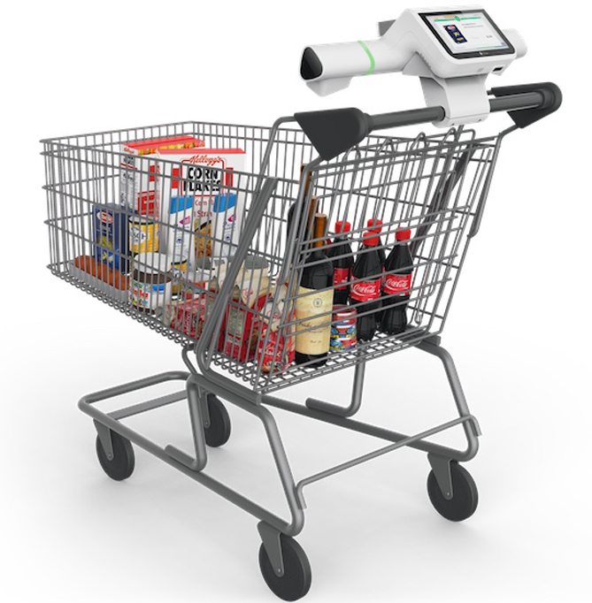











Retail FE Evolution
Devices / Touch point
Functionality

Slide 9
The vision
Using our experience and open-source technology
to build
The ultimate multi retail platform
Powerful, Resilient
&
Affordable

Slide 10
Promise & Challenges
Scalable
Easy to Install & Deploy
Cloud On-premise and local
Seamless Integration
Secure encrypted communication
Multichannel
Running from Any device
Full Offline Functionality
Any Operating system
Any Retail format
Fast Learning Curve
Multi language
Affordable
Protect Hardware investment, very light footprint
No third-parties licenses
User Exit Source Code access to optimize Development & support cost
Agile development team
Subscription model

Slide 11








Retail Transaction Example
Create or resume a Transaction Object
Add Customer
Loyalty info
Finalize
Or suspend
The transaction
Add Items on
your basket
Add Promo & Discount

Slide 12

Memphis Technology
Overview

Slide 13


Modern Micro services Approach
Check-out
GUI & Hardware Interface
Transaction Manager
Promo Engine
Micro-
services
Cloud Infrastructure
Payments
Loyalty
Gift Cards
Transaction Manager
Promo Engine

Slide 14
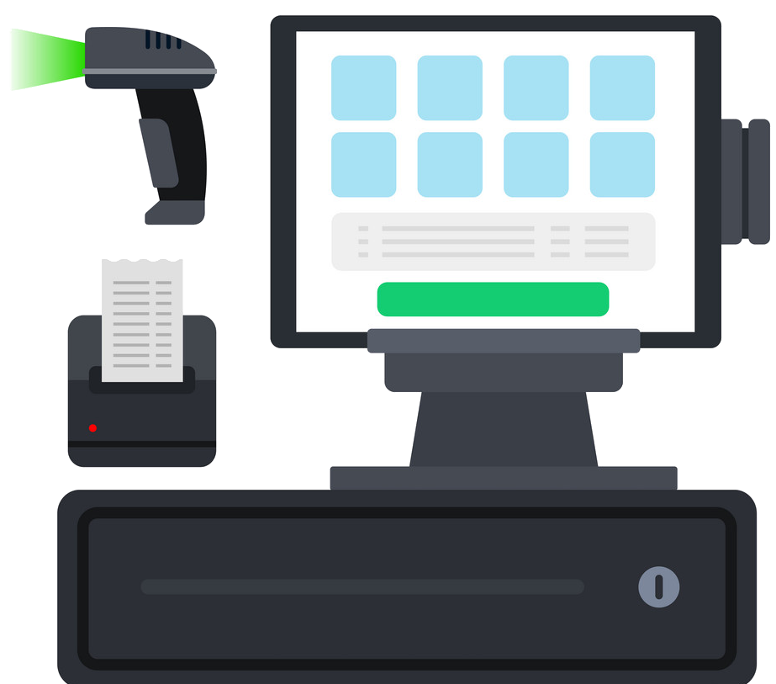
Memphis POS Stack
GUI (Ionic under Chrome)
Transaction manager
Promotion Engine (PIM)
Java Hardware Interface Manager (JHIM)
Retail Bus (Rebus)
Postgresql
Linux (Debian 11)

Slide 15
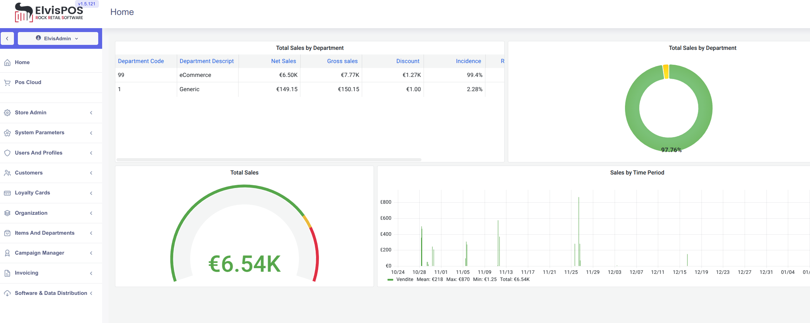
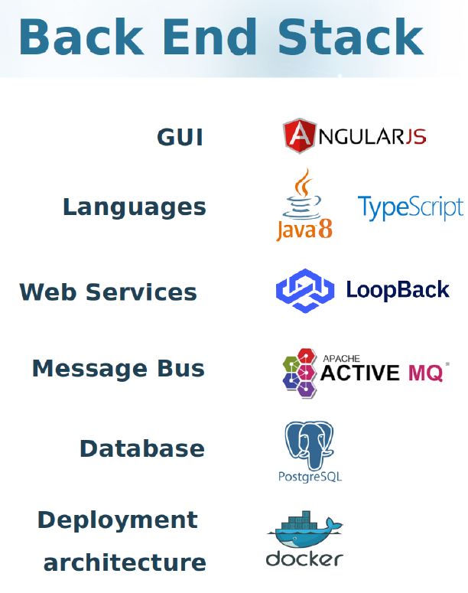
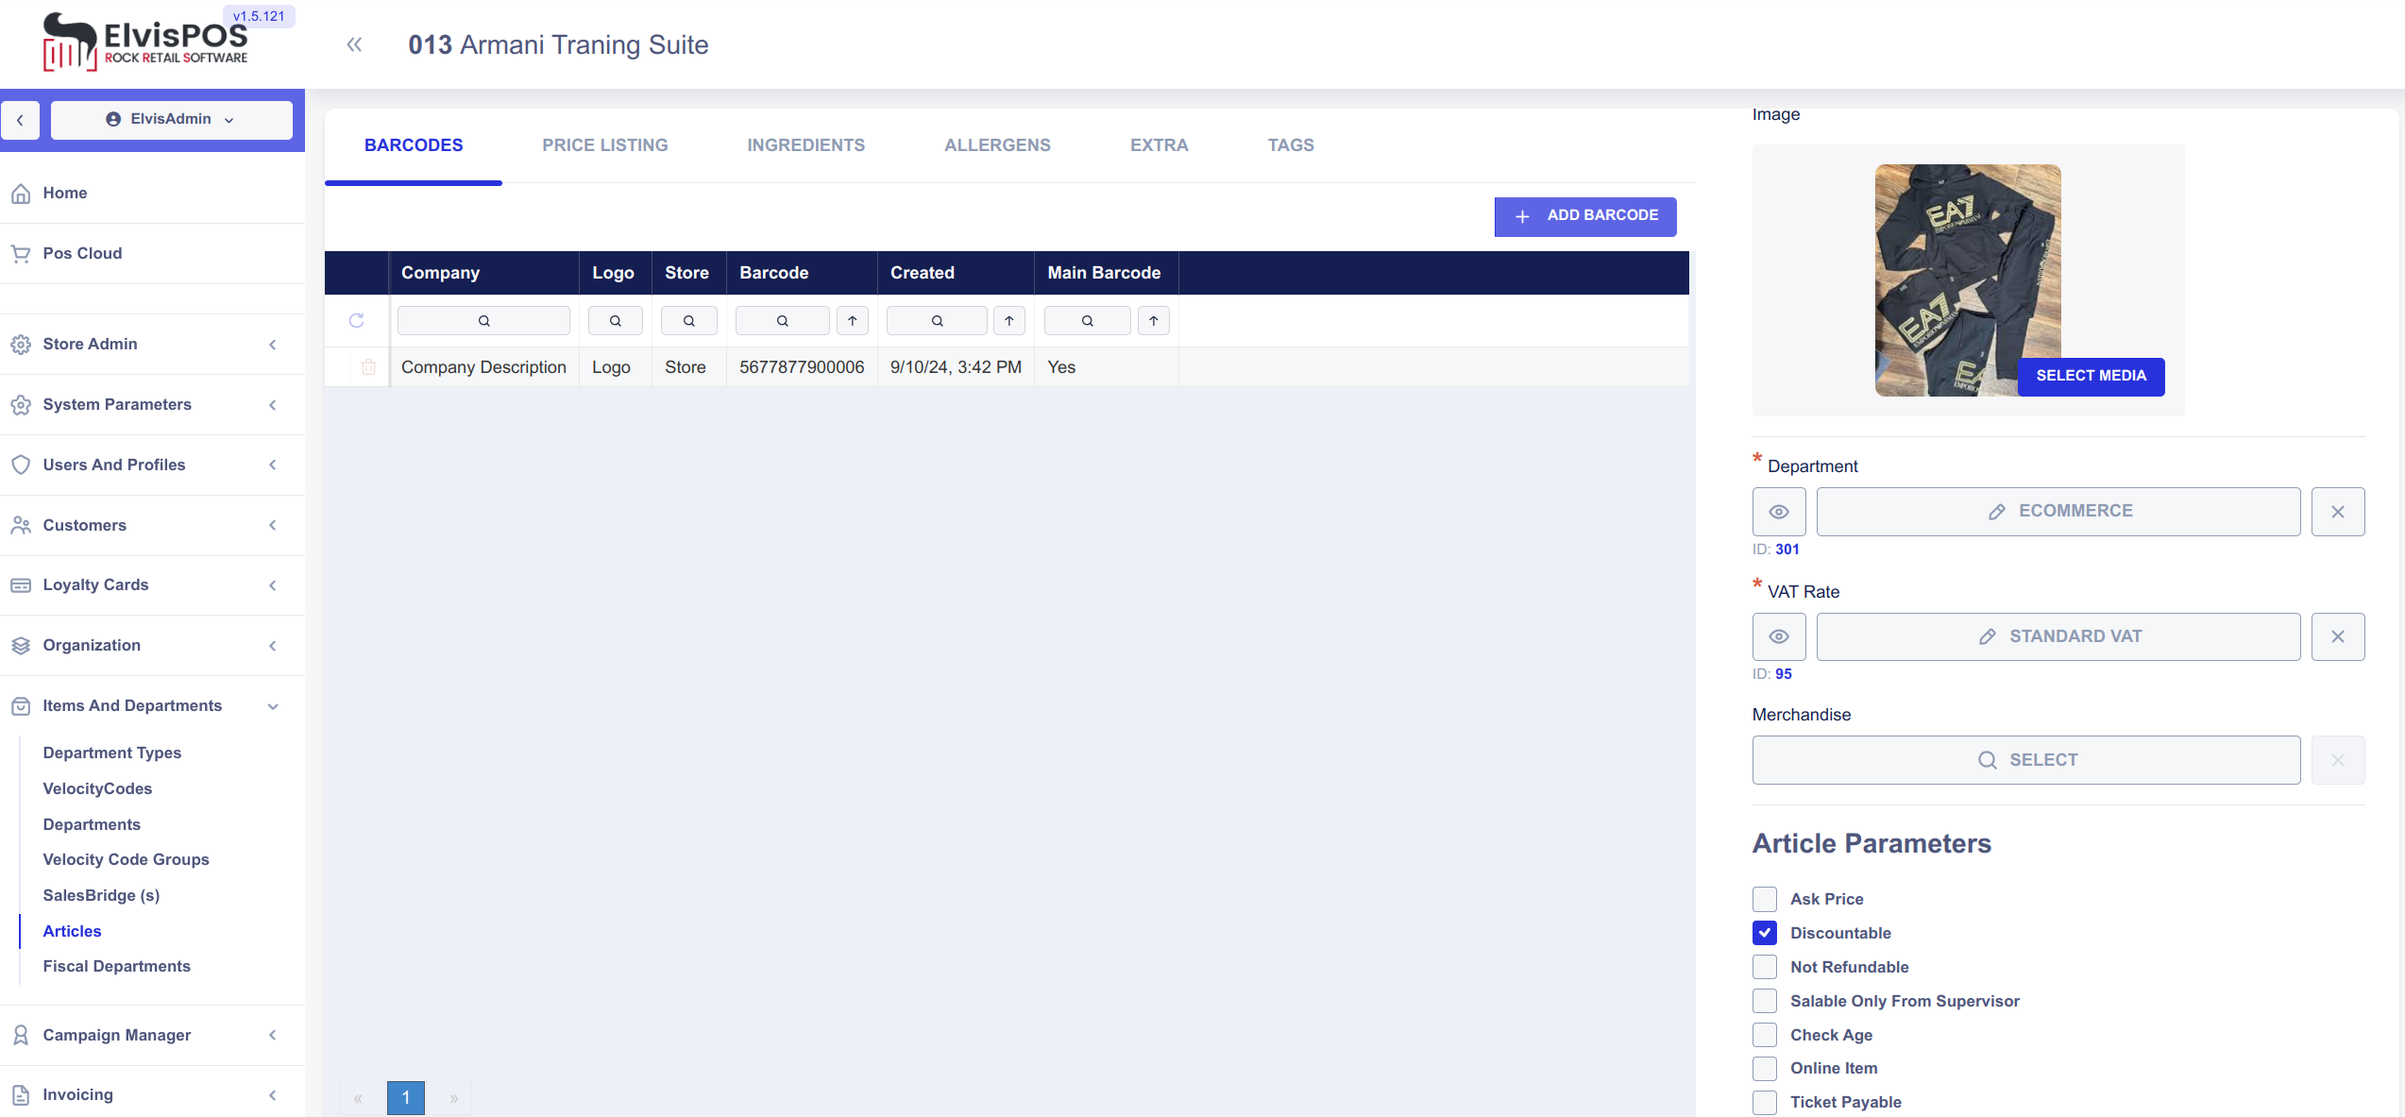
Memphis Front Office Stack

Slide 16

Why Docker?
Memphis Containers
It is a Containers Builder
Container has IP address and logical name
Containers are “waterproof”
Each container has a mission
Containers can be deployed on virtual or physical machines
Artemis Active MQ
Postgresql
Web Reporting tool
Transaction Manager
Cloud POS
Workflow/Sentinel
Import / Export
Kiosk / Info point

Slide 17





Deploy Option Overview
1-2 or 3 Levels
Full Thin
Server Less
Traditional
Full Offline and Recovery guarantee
By Memphis Retail-Bus architecture

Slide 18

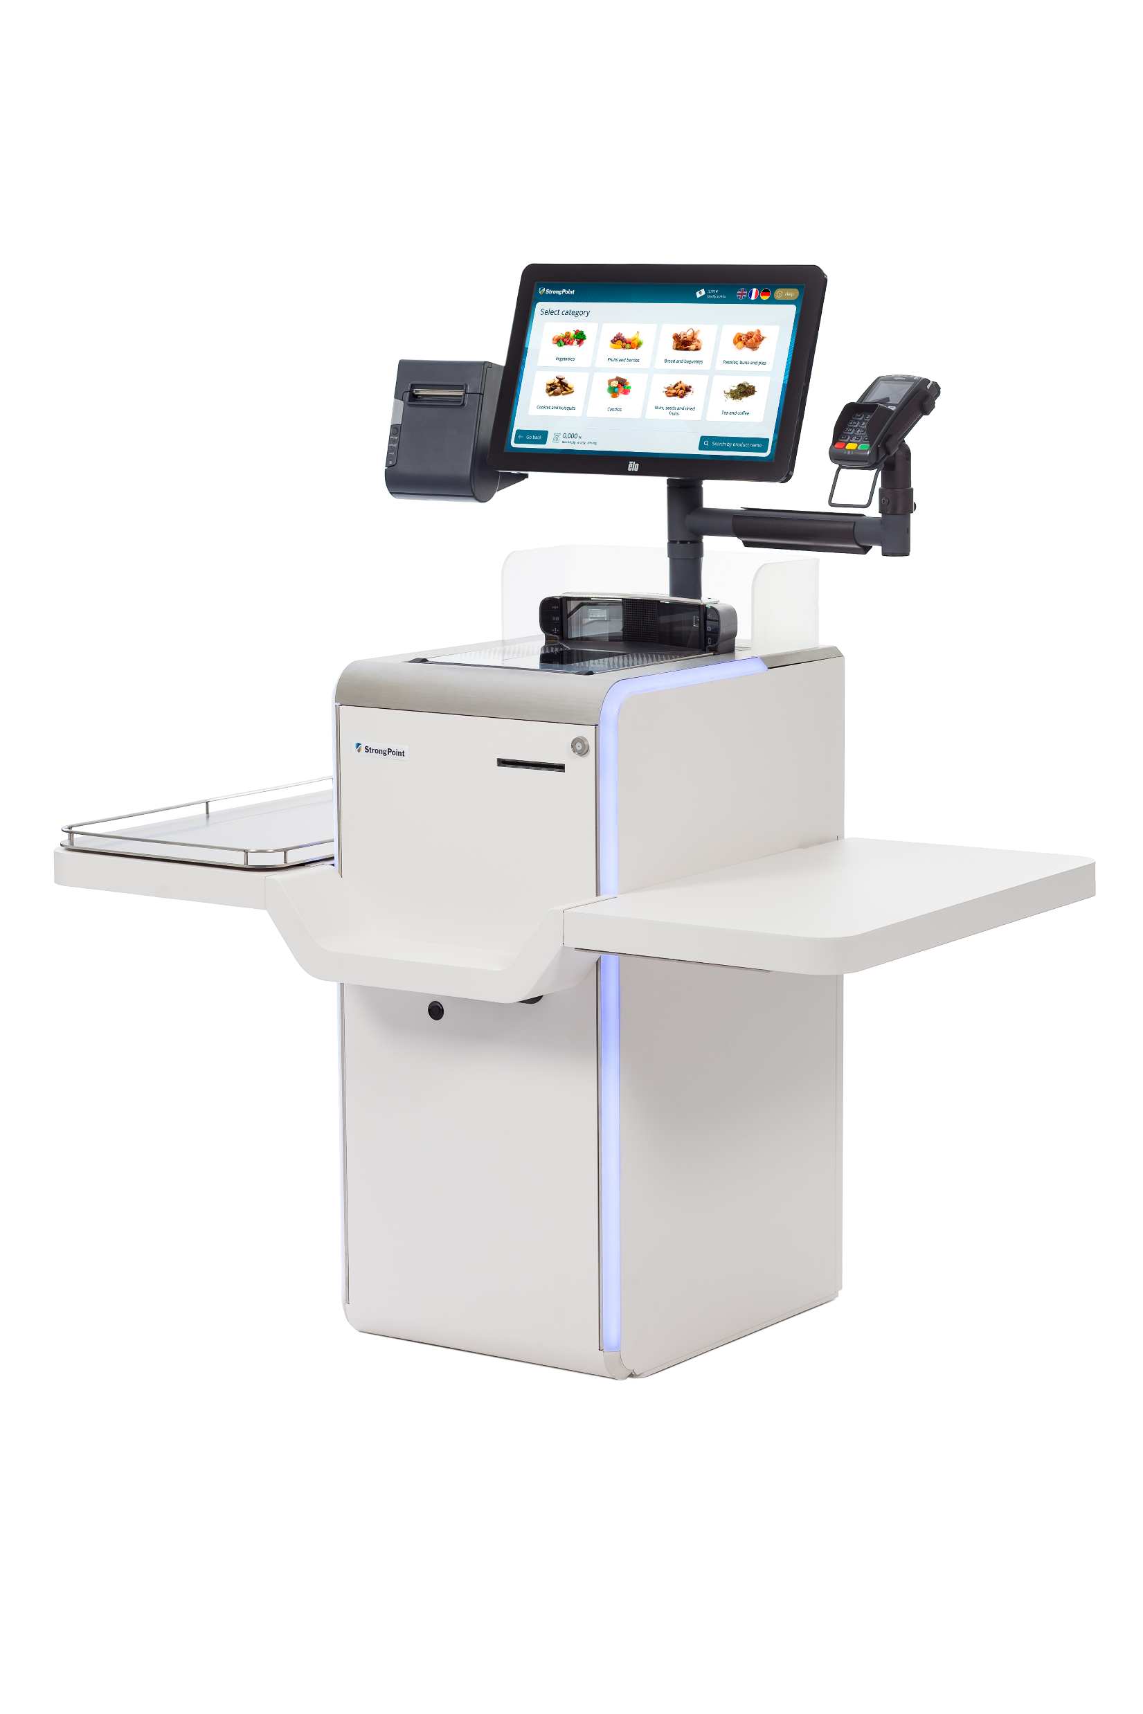
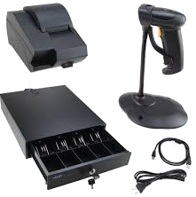



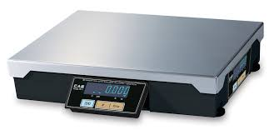
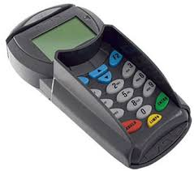
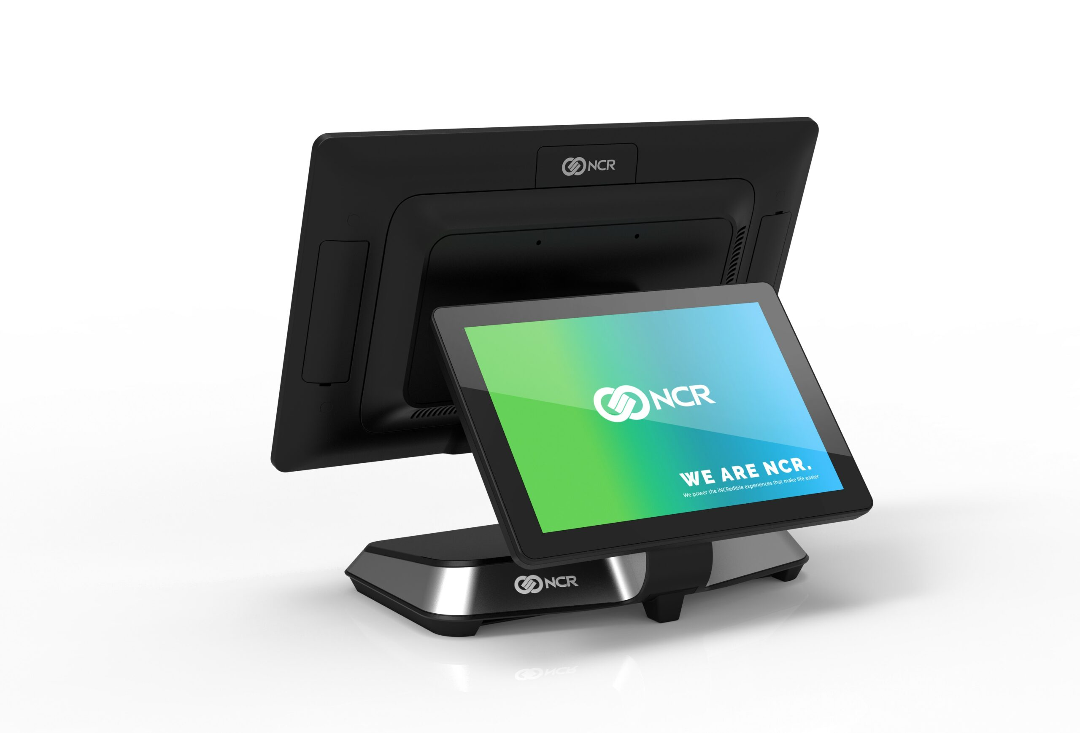
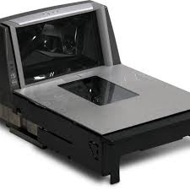
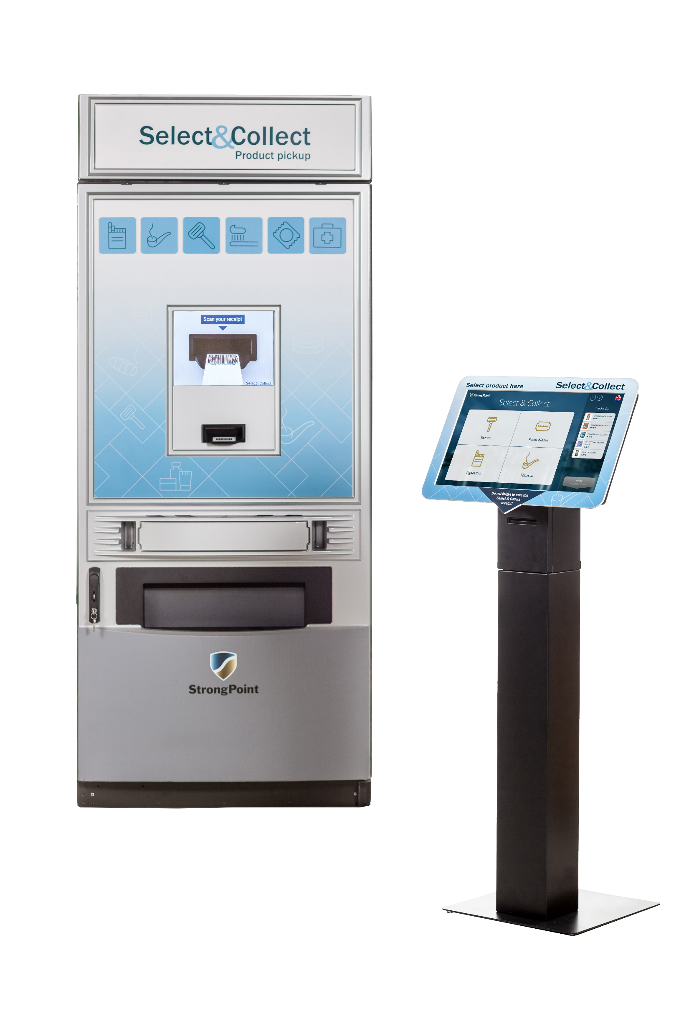
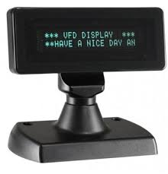
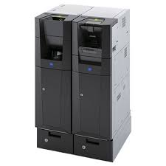
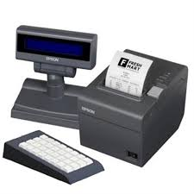
JHIM Overview
JHIM
Java Hardware Interface Manager
Translate Hardware specific
protocol into Web Socket
Standard Memphis Interface
IOT for Retail Devices

Slide 19
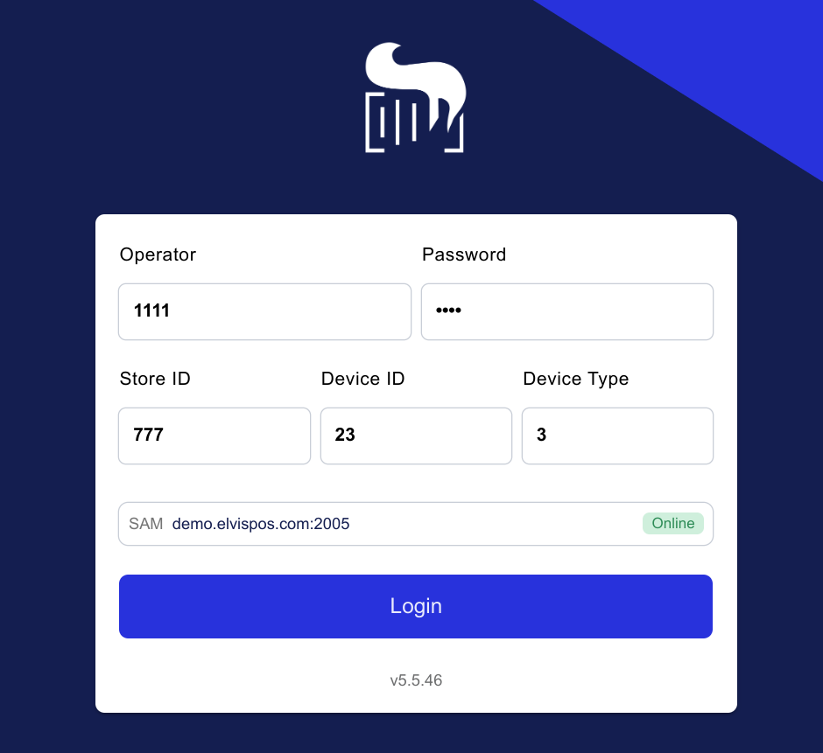
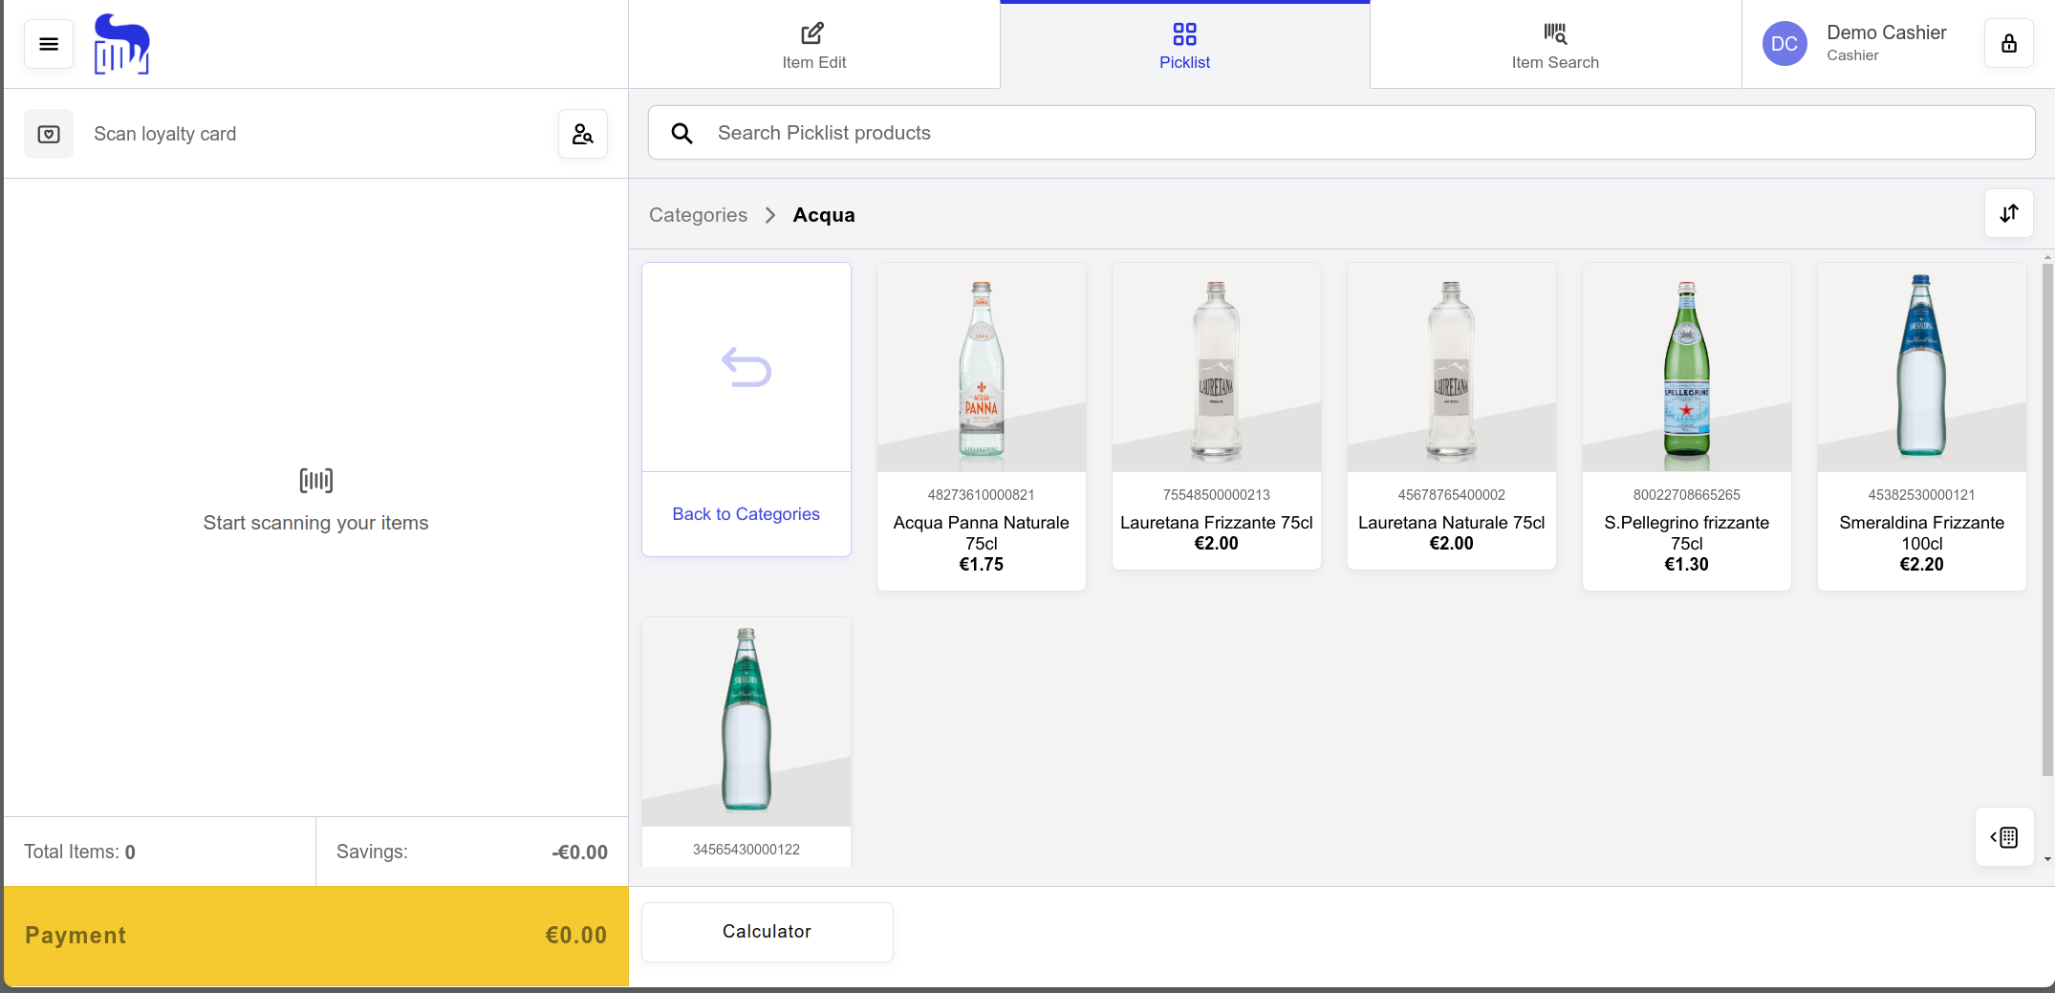
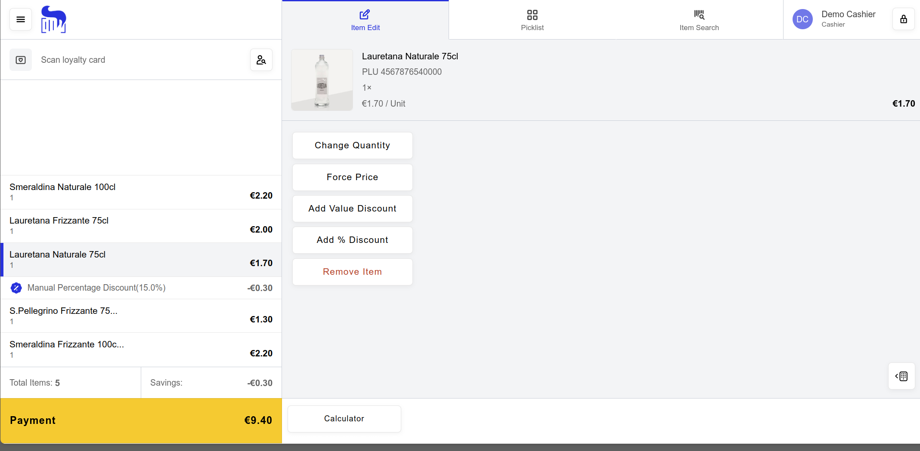
GUI Overview

Slide 20
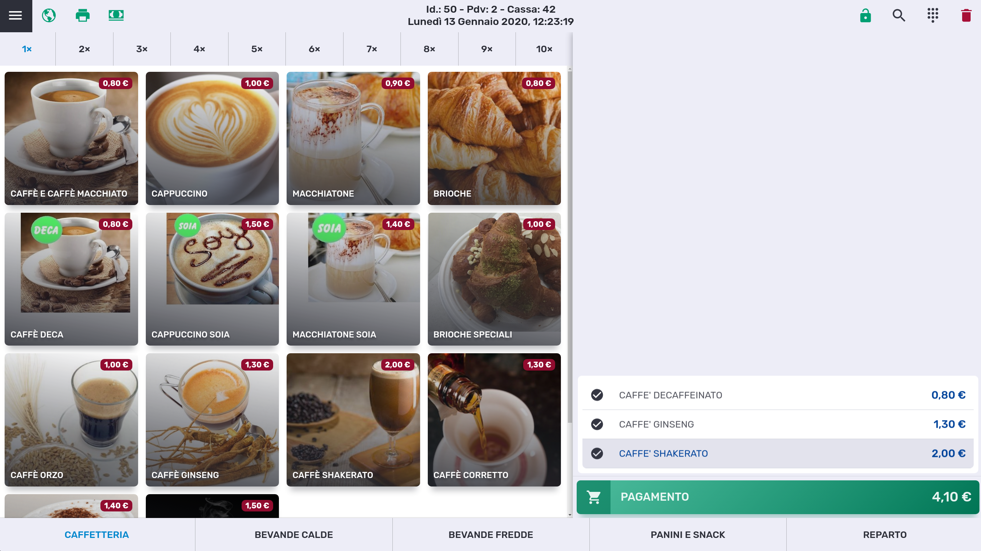

GUI Overview

Slide 21
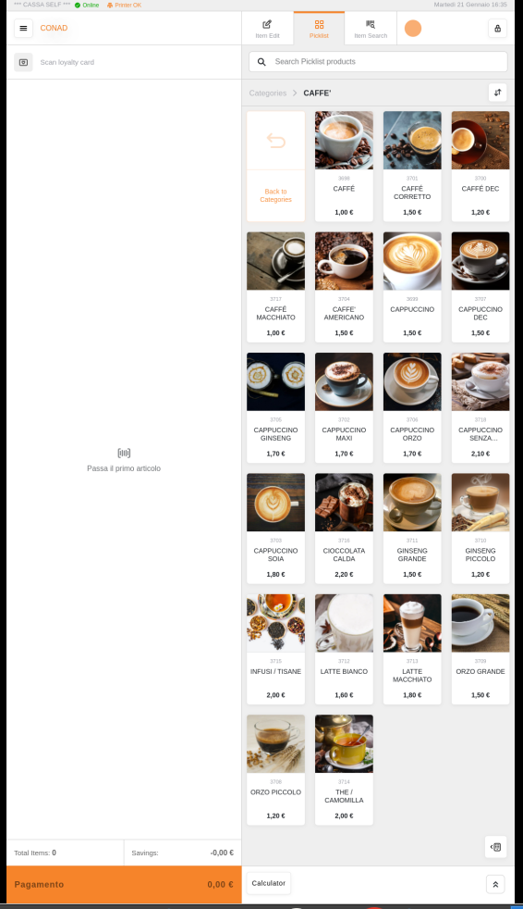
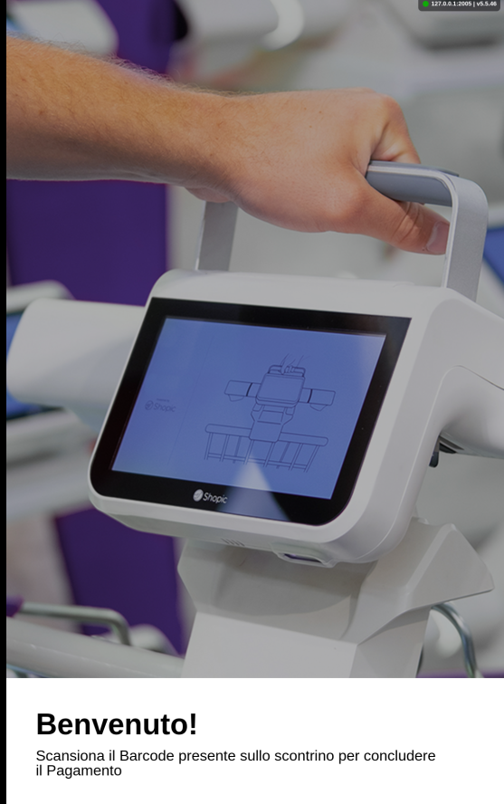

GUI Overview

Slide 22






Front End Transaction Flow
JHIM
Detects
An
Event
GUI
Operator
Interaction
JHIM
Eft/CM
Payment
Request
JHIM
Print or
fiscal
Request
Transaction Manager
Rebus
Execute
DB or
WS access
PIM
Engine
Apply
Promos
Rebus
Commit
Transaction
Object

Slide 23

Memphis and e-commerce

Slide 24


E-commerce Transaction flow
Payment
Transaction Manager
Rebus
Execute
DB or
WS access
PIM
Engine
Apply
Promos
Rebus
Commit
Transaction log

Slide 25
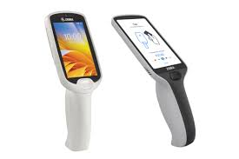
Shopic & Scan & Go
Both integration implemented in few weeks! Standard API + POS deployed in cloud
Transaction Manager
Rebus
Execute
DB or
WS access
PIM
Engine
Apply
Promos
Rebus
Commit
Transaction log

Slide 26




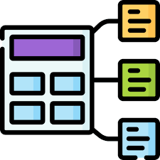


Store Reporting
At Store Level Reports are provided using Grafana
Open source working on not aggregated data. Fully customizable even from the Customer
Available via mobile
db_offlog
rdb_log
rdb_log_item
db_offlog
rdb_log_Tender
Funzioni postgresql
db_offlog
STAGER

Slide 27
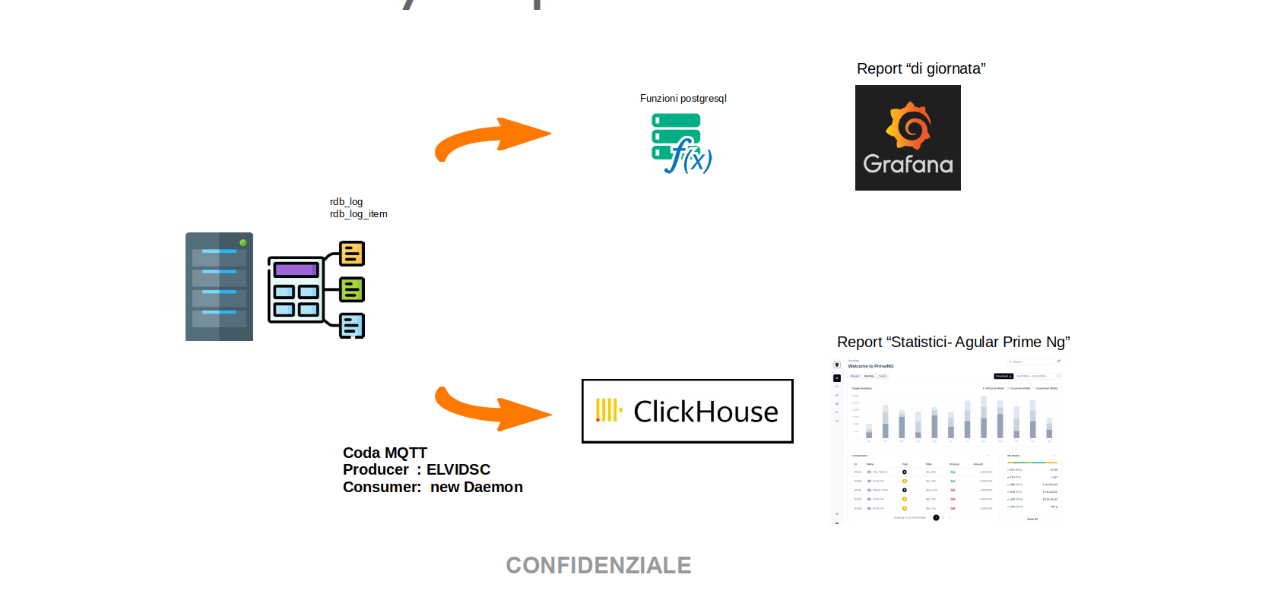
Centralized Reporting
ClickHouse is a column data base, not relational designed to work with large data volumes
It optimize queries and it can compess data.
Extends standard SQL enriching it with aggregation function.
ClickHouse gives OLAP speed without OLAP complexity

Slide 28
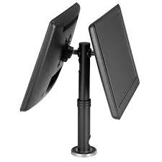
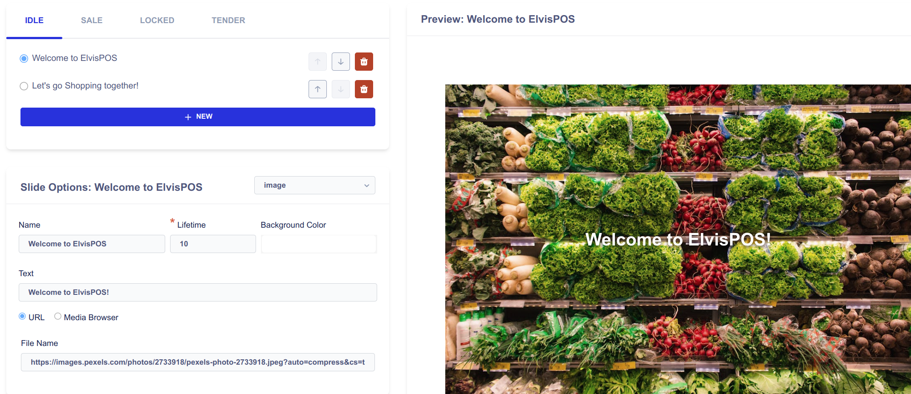
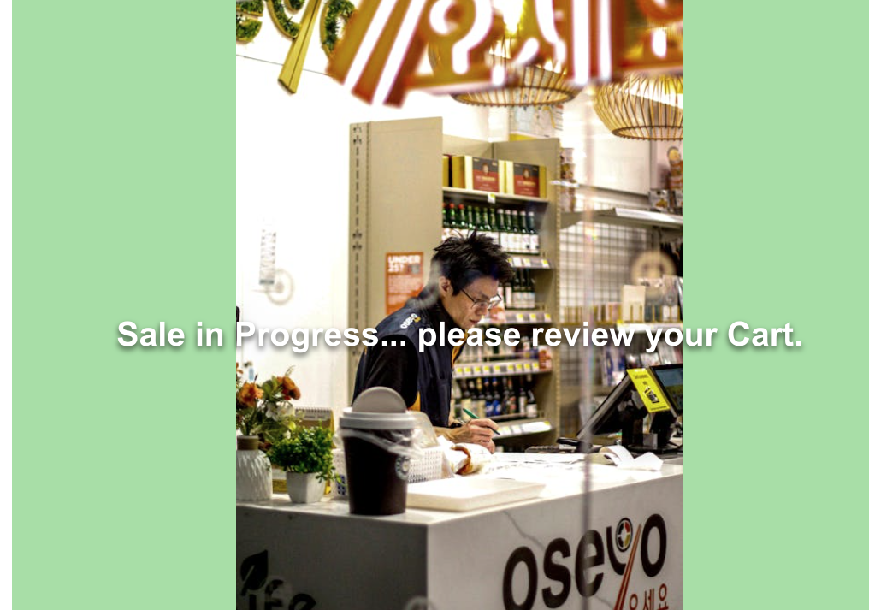
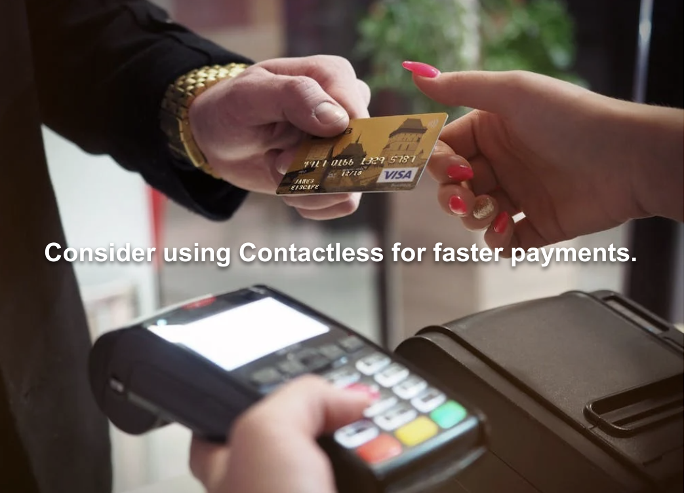
Kiosk Content
We can program multimedia content for the customers. It can be image, video or web site. It is possible to program the time range and the cash register status.
Like Content XX between hh:mm and hh:mm when in IDLE

Slide 29

Memphis Software Distribution

Slide 30
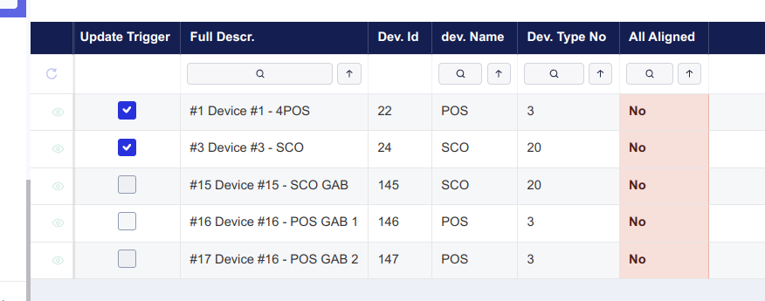
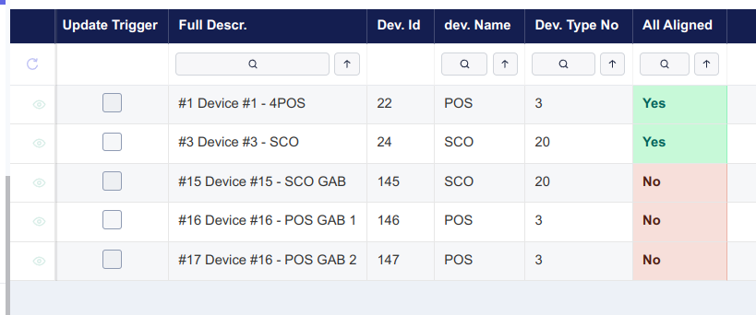
Native Software distribution
Software is pulled from GOLD server
“ecli sync” command pull Software and data model
Scheduled or manually invoked
Identical procedure on Server and POS

Slide 31
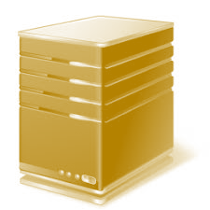
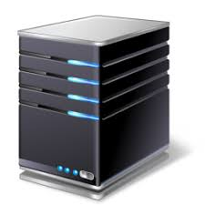
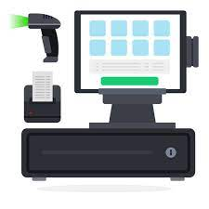
Software distribution: proposed configuration
Sync from
Elvispos
Gold
Silver Central Production
Silver Central QA
Store1 Production
Store2 Production
Store QA

Slide 32
D
E
M
O

